Slide 1

ASP.NET Core Security
Damien Bowden Microsoft MVP
https://damienbod.com
@damien_bod

Slide 2





https://github.com/damienbod angular-auth-oidc-client npm ASP.NET Core, Angular

Slide 3
Security & Applications today
OpenID Connect, OAuth2
Protecting APIs
Authorization: ASP.NET Core Policies
Web security attacks, fixes, best practises
Test Tools
Data Breaches

Slide 4

Security & Applications today
Notes:
Explain one stop apps, reusing company AAA

Slide 5

Application
Notes:
App in one

Slide 6
Application
Authentication
Business
Authorization
Data Access
Identity
Notes:
What is Authentication?
Is the process of verifying an identity (who they say they are)
What is Authorization?
Is the process of verifying what someone is allowed to do (permissions)
What is an Identity?
User + Application

Slide 7
Application 2
Authentication
Business
Application
Authorization
Data Access
Authentication
Business
Identity
Authorization
Data Access
Identity

Slide 8
Application 2
Authentication
Business
Application
Authorization
Data Access
Authentication
Business
Identity
Authorization
Data Access
Identity

Slide 9
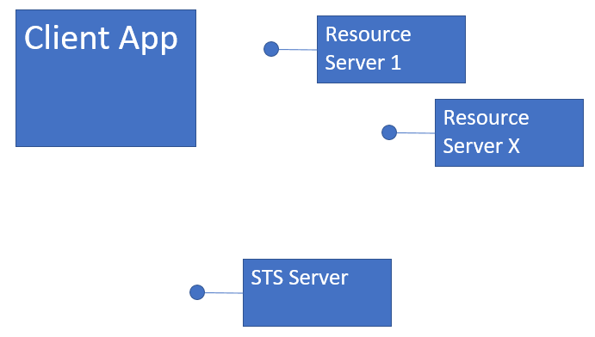

Slide 10


Slide 11
HTTPS everywhere, Certs

Slide 12
HTTPS everywhere, Certs
Protected Zone
WAF

Slide 13
HTTPS everywhere, Certs
Protected Zone
WAF

Slide 14
Authentication, Authorization, Accounting
Session Protection HTTPS headers, Meta Headers
HTTPS Certs TLS 1.0, 1.2
WAF Web Application Firewall
Notes:
What do you need to do when you are architecting your application?

Slide 15
Authorization
Authentication
Session
Signout
Notes:
User with client => Identity

Slide 16


Slide 17
OpenID Connect
Authentication
OAuth2
Authorization

Slide 18
OpenID Connect
http://openid.net/connect/
Standard, Specification
Authentication and Authorization
built on top of OAuth2 (access control)
Identity (Person can have n Identities)
UserInfo Endpoint
Notes:
TODO, needs to be improved

Slide 19
Open ID Connect (OIDC) is supported by almost all systems.
Azure AD, Azure B2C, OKTA, IdentityServer4, google accounts, Openiddict, node-oidc-provider

Slide 20
Authorization
Authentication
Session
Signout

Slide 21
id token token (access token) reference token refresh token
scope Back-Channel Front-Channel User Agent
Notes:
id_token
Identity token for the Application
Validated, opened by Client Application
not to be used for API access
access _token
access token for APIs, Resources
Not opened, by Client Application
Implicit validation on Client using the at_hash
To be used for API access, resources.
Can by any format, not just a JWT
reference _token
random string, no defined format
references an access_token
easy to control the lifecycle
makes it possible that access_token must never leave the safe zone
refresh token
random string, no defined format
Used to refresh the tokens
Not Implicit Flow
Scope
Identity scopes
API or Resource scopes
managing your claims, grouping, APIs
OpenID scopes openid, profile, email, phone

Slide 22
OpenID Connect Flows/OAuth2 Security Flows
http://openid.net/specs/openid-connect-core-1_0.html
OIDC Implicit flow
OIDC Hybrid flow
OIDC Code flow
OAuth2 Resource Owner Credentials Flow
Native App PKCE Authorization Code Flow RFC 7636
Device Flow

Slide 23
OpenID Connect Implicit flow
For browser applications, SPAs
Client is not authenticated, or trusted
response_type = id_token token
response_type = id_token

Slide 24
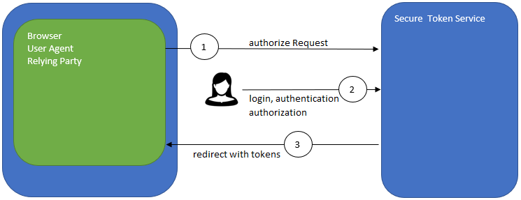
OpenID Connect Implicit flow
Notes:
The Implicit Flow is mainly used by Clients implemented in a browser using a scripting language. The Access Token and ID Token are returned directly to the Client, which may expose them to the End-User and applications that have access to the End-User's User Agent. The Authorization Server does not perform Client Authentication.
Steps:
Client prepares an Authentication Request containing the desired request parameters.
Client sends the request to the Authorization Server.
Authorization Server Authenticates the End-User.
Authorization Server obtains End-User Consent/Authorization.
Authorization Server sends the End-User back to the Client with an ID Token and, if requested, an Access Token.
Client validates the ID token and retrieves the End-User's Subject Identifier.

Slide 25
OIDC Authorization Code flow
Server to server applications with User
Can keep secrets, is trusted
Client is authenticated
response_type = code

Slide 26
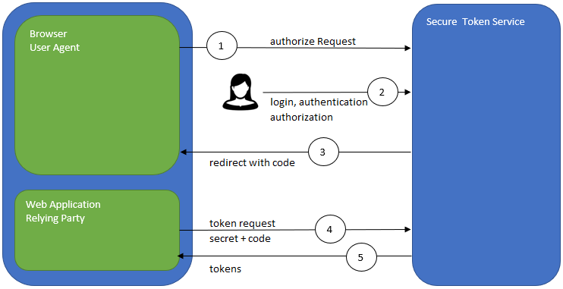
OIDC Authorization Code flow
Notes:
The Authorization Code Flow returns an Authorization Code to the Client, which can then exchange it for an ID Token and an Access Token directly. This provides the benefit of not exposing any tokens to the User Agent and possibly other malicious applications with access to the User Agent. The Authorization Server can also authenticate the Client before exchanging the Authorization Code for an Access Token. The Authorization Code flow is suitable for Clients that can securely maintain a Client Secret between themselves and the Authorization Server.
Steps:
Client prepares an Authentication Request containing the desired request parameters.
Client sends the request to the Authorization Server.
Authorization Server Authenticates the End-User.
Authorization Server obtains End-User Consent/Authorization.
Authorization Server sends the End-User back to the Client with an Authorization Code.
Client requests a response using the Authorization Code at the Token Endpoint.
Client receives a response that contains an ID Token and Access Token in the response body.
Client validates the ID token and retrieves the End-User's Subject Identifier.

Slide 27
OIDC Hybrid flow
Mix of the Code and Implicit Flow
Can be used for Web applications with server side rendering.
response_type = code id_token
response_type = code id_token token
response_type = code token

Slide 28
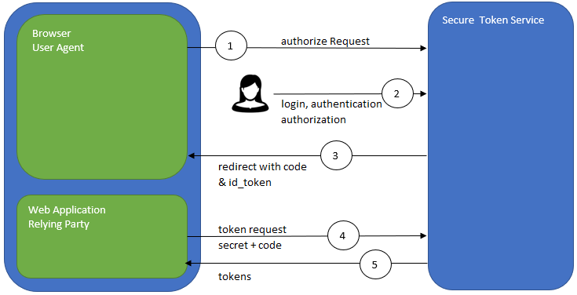
OIDC Hybrid flow
Notes:
http://openid.net/specs/oauth-v2-multiple-response-types-1_0.html
Steps:
Client prepares an Authentication Request containing the desired request parameters.
Client sends the request to the Authorization Server.
Authorization Server Authenticates the End-User.
Authorization Server obtains End-User Consent/Authorization.
Authorization Server sends the End-User back to the Client with an Authorization Code and, depending on the Response Type, one or more additional parameters.
Client requests a response using the Authorization Code at the Token Endpoint.
Client receives a response that contains an ID Token and Access Token in the response body.
Client validates the ID Token and retrieves the End-User's Subject Identifier.
code token
When supplied as the value for the response_type parameter, a successful response MUST include an Access Token, an Access Token Type, and an Authorization Code. The default Response Mode for this Response Type is the fragment encoding and the query encoding MUST NOT be used. Both successful and error responses SHOULD be returned using the supplied Response Mode, or if none is supplied, using the default Response Mode.
code id_token
When supplied as the value for the response_type parameter, a successful response MUST include both an Authorization Code and an id_token. The default Response Mode for this Response Type is the fragment encoding and the query encoding MUST NOT be used. Both successful and error responses SHOULD be returned using the supplied Response Mode, or if none is supplied, using the default Response Mode.
id_token token
When supplied as the value for the response_type parameter, a successful response MUST include an Access Token, an Access Token Type, and an id_token. The default Response Mode for this Response Type is the fragment encoding and the query encoding MUST NOT be used. Both successful and error responses SHOULD be returned using the supplied Response Mode, or if none is supplied, using the default Response Mode.
code id_token token
When supplied as the value for the response_type parameter, a successful response MUST include an Authorization Code, an id_token, an Access Token, and an Access Token Type. The default Response Mode for this Response Type is the fragment encoding and the query encoding MUST NOT be used. Both successful and error responses SHOULD be returned using the supplied Response Mode, or if none is supplied, using the default Response Mode.

Slide 29
OAuth2 Resource Owner Credentials Flow
MC to MC applications
trusted client
grant_type=client_credential&client_id=xxxxxxxxxx&client_secret=xxxxxxxxxx
Limited user cases

Slide 30
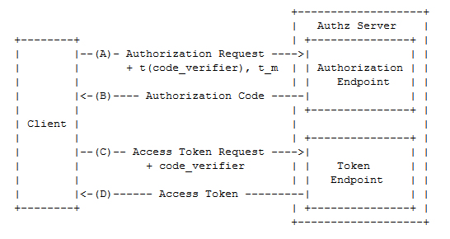
Native App PKCE Authorization Code Flow RFC 7636
https://tools.ietf.org/html/rfc7636

Slide 31
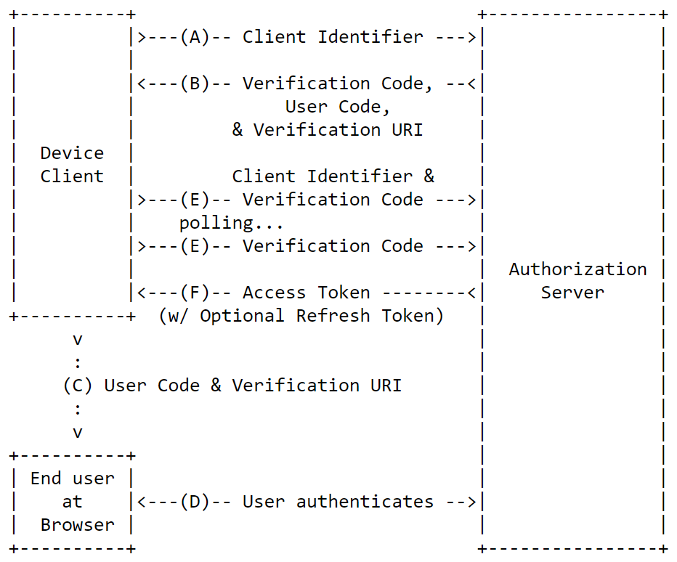
https://tools.ietf.org/html/draft-ietf-oauth-device-flow-12
Device Flow

Slide 32
https://github.com/damienbod/AspNetCoreWindowsAuth https://github.com/damienbod/AspNetCoreHybridFlowWithApi
Demo OpenID Hybrid Flow
ASP.NET Core MVC

Slide 33
Protecting APIs

Slide 34
JWT Bearer Authentication Introspection Cookies … not for APIs

Slide 35
Public APIs use same access_token Private APIs, APIs in protected Zones use a new access_token, not the public access_token

Slide 36
Authorization: ASP.NET Core Policies

Slide 37
Authorization is the responsibility of the Application / API, not the STS.
This can be implemented in an separate library.
Notes:
Claims in the id_token, access_token provide the properties so that API, APP can do the Authorization

Slide 38
Standard Requirements
Complex Requirements
Policies uses Requirements
Authorization Handlers

Slide 39
Authorization Code Demo
Notes:
public class IsAdminBobHandler : AuthorizationHandler<IsAdminRequirement>
{
private readonly IAppAuthorizationService _appAuthorizationService;
public IsAdminBobHandler(IAppAuthorizationService appAuthorizationService)
{
_appAuthorizationService = appAuthorizationService;
}
protected override Task HandleRequirementAsync(AuthorizationHandlerContext context, IsAdminRequirement requirement)
{
if(_appAuthorizationService.IsAdminDamien(context.User.Identity.Name))
{
context.Succeed(requirement);
}
return Task.CompletedTask;
}
}

Slide 40
Web security attacks fixes, best practises

Slide 41
Authorization
Authentication
Session
Signout

Slide 42
Downloading secure files
One time tokens
Never allow the “access_token” in the path of the URL, only use as a url parameter => encrypted when using HTTPS
Avoid the parameters as well if possible => Logs

Slide 43
Web Sockets
Problem: cannot send the token in the header!
Never allow the “access_token” in the path of the URL, only in the parameters of the request.

Slide 44
Client side code injection Persistent XSS, where the malicious string originates from the website's database. Reflected XSS, where the malicious string originates from the victim's request. DOM-based XSS, where the vulnerability is in the client-side code rather than the server-side code. src: https://excess-xss.com/ # Same Origin Policy (active per default), set CORS for your website # X-XSS-Protection (Http Header) # Use Content Security Policy (prevents inline code) # HTML output avoid if possible, or HTML encode
Cross Site Scripting XSS

Slide 45
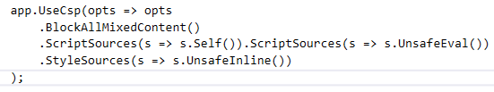
content-security-policy: default-src 'self’ content-security-policy: script-src 'self' 'unsafe-eval';style-src 'unsafe-inline';block-all-mixed-content
CSP Content Security Policy

Slide 46
Access-Control-Allow-Origin: http://foo.example Access-Control-Allow-Methods: POST, GET, OPTIONS Access-Control-Allow-Headers: X-PINGOTHER, Content-Type Access-Control-Max-Age: 86400 https://docs.microsoft.com/en-us/aspnet/core/security/cors
CORS Cross-Origin Resource Sharing

Slide 47
Cross-Site Request Forgery (CSRF)
Attacker gets the users identity
A bigger problem when using cookies
Use anti-forgery cookies to protect against this

Slide 48
# HTTPS, encryption # HSTS (HTTP Strict Transport Security ) # Strict-Transport-Security: max-age=33333333 (browser internal redirects) https://hstpreload.appspot.com app.UseHsts(o = o.MaxAge(days:365).Preload()
Sensitive Data Exposure

Slide 49
Force HTTPS
Man in the middle attack [RequireHttps] Startup o => o.Filters.Add(new RequireHttpsAttribute())

Slide 50
Protect the CDNs
For scripts and css, a SRI should used.
SRI: Subresource Integrity

Slide 51
Session hijacking
SPA problems with Cookies # use tokens
MVC
# Cookies, use same site, html only

Slide 52
Open redirect Attack
IsLocalRedirect(), only allows relative urls https://docs.microsoft.com/en-us/aspnet/core/security/preventing-open-redirects?view=aspnetcore-2.0

Slide 53
Access control to data & functions
admin, non authorization, extra properties in DTO
good View Model design, Read Models, Update Models, Create Models

Slide 54
Phishing
# links should always include:
rel="noopener noferrer"

Slide 55
Under protected APIs
Why ?

Slide 56
Don't mix cookies and tokens in one API
# Limit by scheme (ActiveAuthenicationSchemes = "Bearer") ASP.NET Core has only one now per method, controller, application etc.

Slide 57

Use secure cookies only ! Use HTTP only cookies ! Use Same site if possible!

Slide 58
NWebsec Nuget package for HTTPS Headers
https://github.com/NWebsec/NWebsec

Slide 59
Test Tools

Slide 60

https://securityheaders.com/

Slide 61
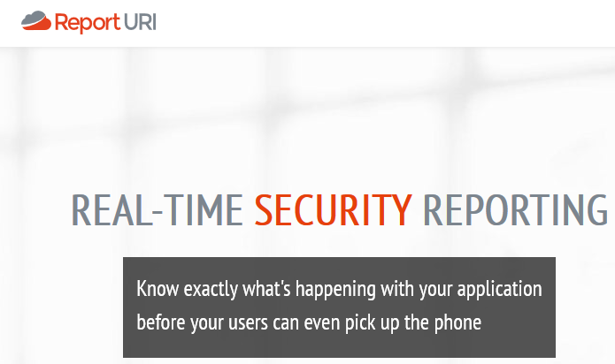
https://report-uri.com/

Slide 62
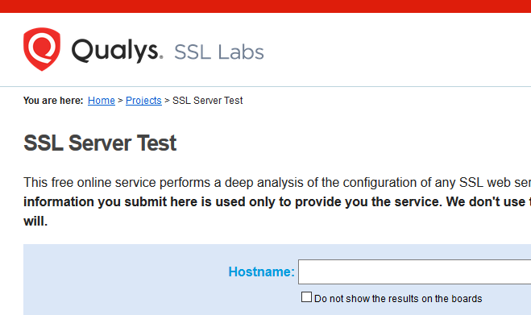
https://www.ssllabs.com/ssltest/

Slide 63

https://observatory.mozilla.org/

Slide 64
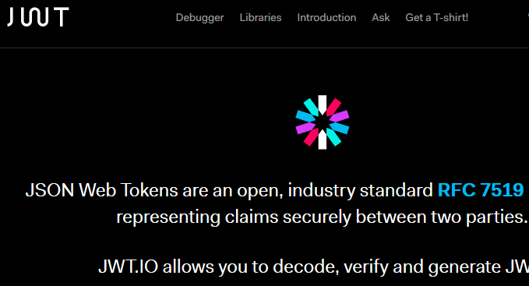
https://jwt.io/

Slide 65
Data Breaches

Slide 66
Prepare for Data Breaches, Defined process for this event
Add a security.txt with breach contact details
Fast build / deployments must be possible

Slide 67
Thank you @damienbod

Slide 68
https://openid.net/developers/specs/
https://github.com/damienbod/AspNet5IdentityServerAngularImplicitFlow https://medium.com/@darutk/diagrams-of-all-the-openid-connect-flows-6968e3990660 https://www.npmjs.com/package/angular-auth-oidc-client
https://openid.net https://auth0.com/blog/cookies-vs-tokens-definitive-guide https://www.npmjs.com/package/angular-auth-oidc-client https://docs.microsoft.com/en-us/azure/architecture/multitenant-identity/authenticate https://scotthelme.co.uk/say-hello-to-security-txt
https://www.youtube.com/watch?v=g_N9BbLIdk0

